Slide 1

BANKING PORTAL
BASED ON :-
PYTHON
SQL

Slide 2


Slide 3

OBJECTIVE OF OUR PROJECT :-
Connecting to the MySql Database
Creating bank account
Updating your personal data
Transactions-
Withdrawing money
Deposit money
Transfer money to another account (pre-existing)
Check balance
See your past Transaction history

Slide 4
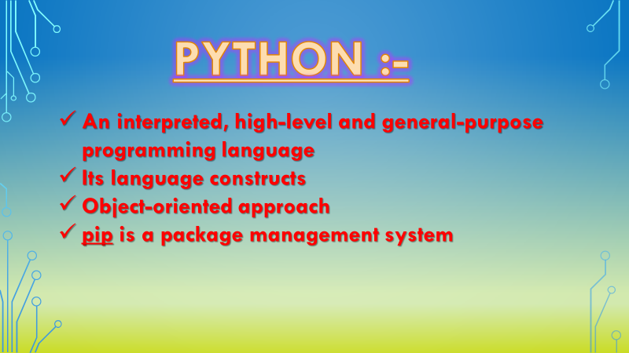

Slide 5
DATABASE :-
An organized collection of data
Data stored in tabular form
Accessed and stored through electronic device
Eg.,- Microsoft SQL Server ,MySQL ,Oracle RDBMS

Slide 6
MY SQL DATABASE :-
SQL stands for Standard Query Language
An open sorce relational database management system
Frequently used database system
Used for websites or other internet driven databases and applications

Slide 7




Slide 8
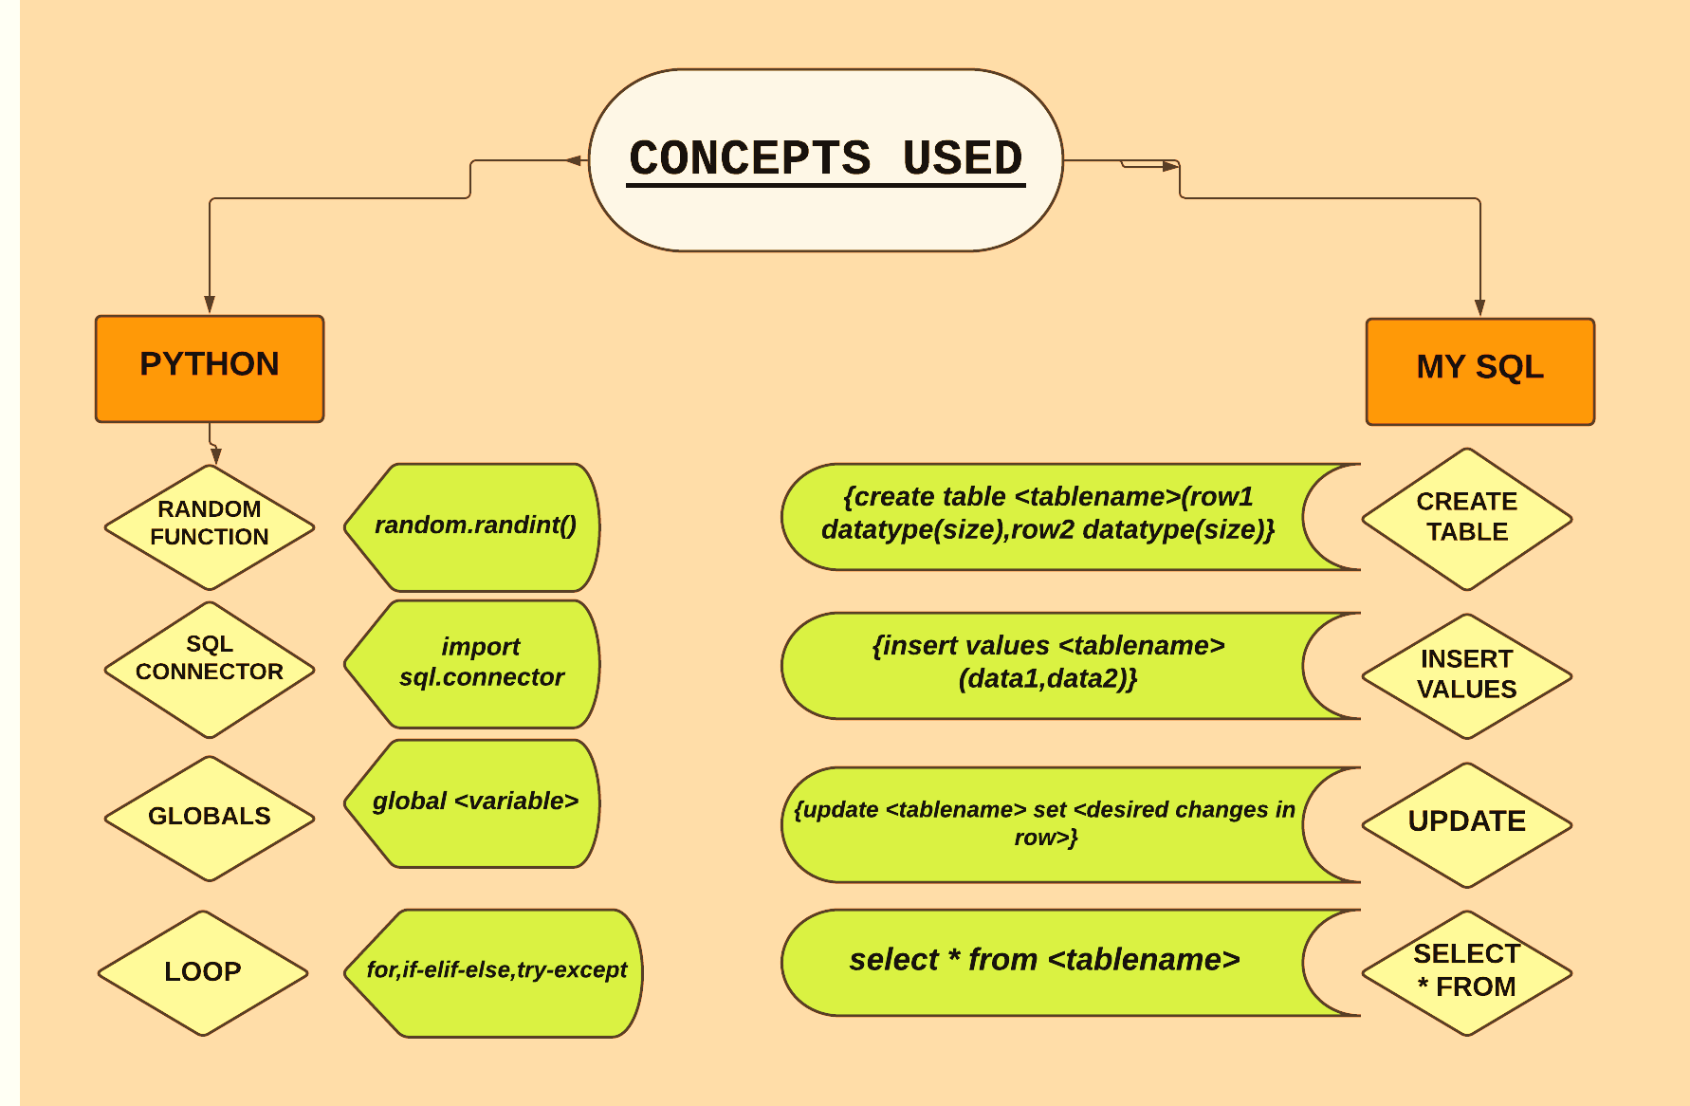

Slide 9
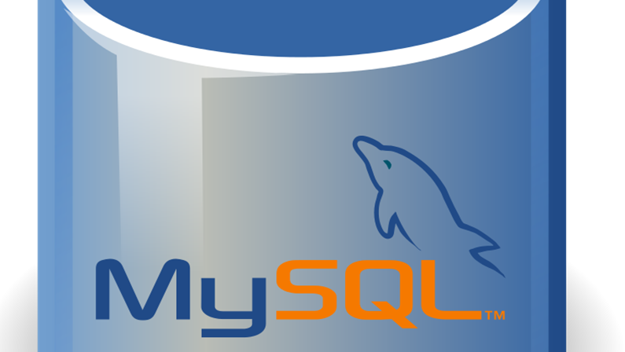
HOW TO CONNECT TO DATABASE
USING PYTHON?

Slide 10


Slide 11

HOW CONTROL FLOWS
THROUGHOUT THE PROGRAM?
This Photo by Unknown Author is licensed under CC BY-NC-ND

Slide 12
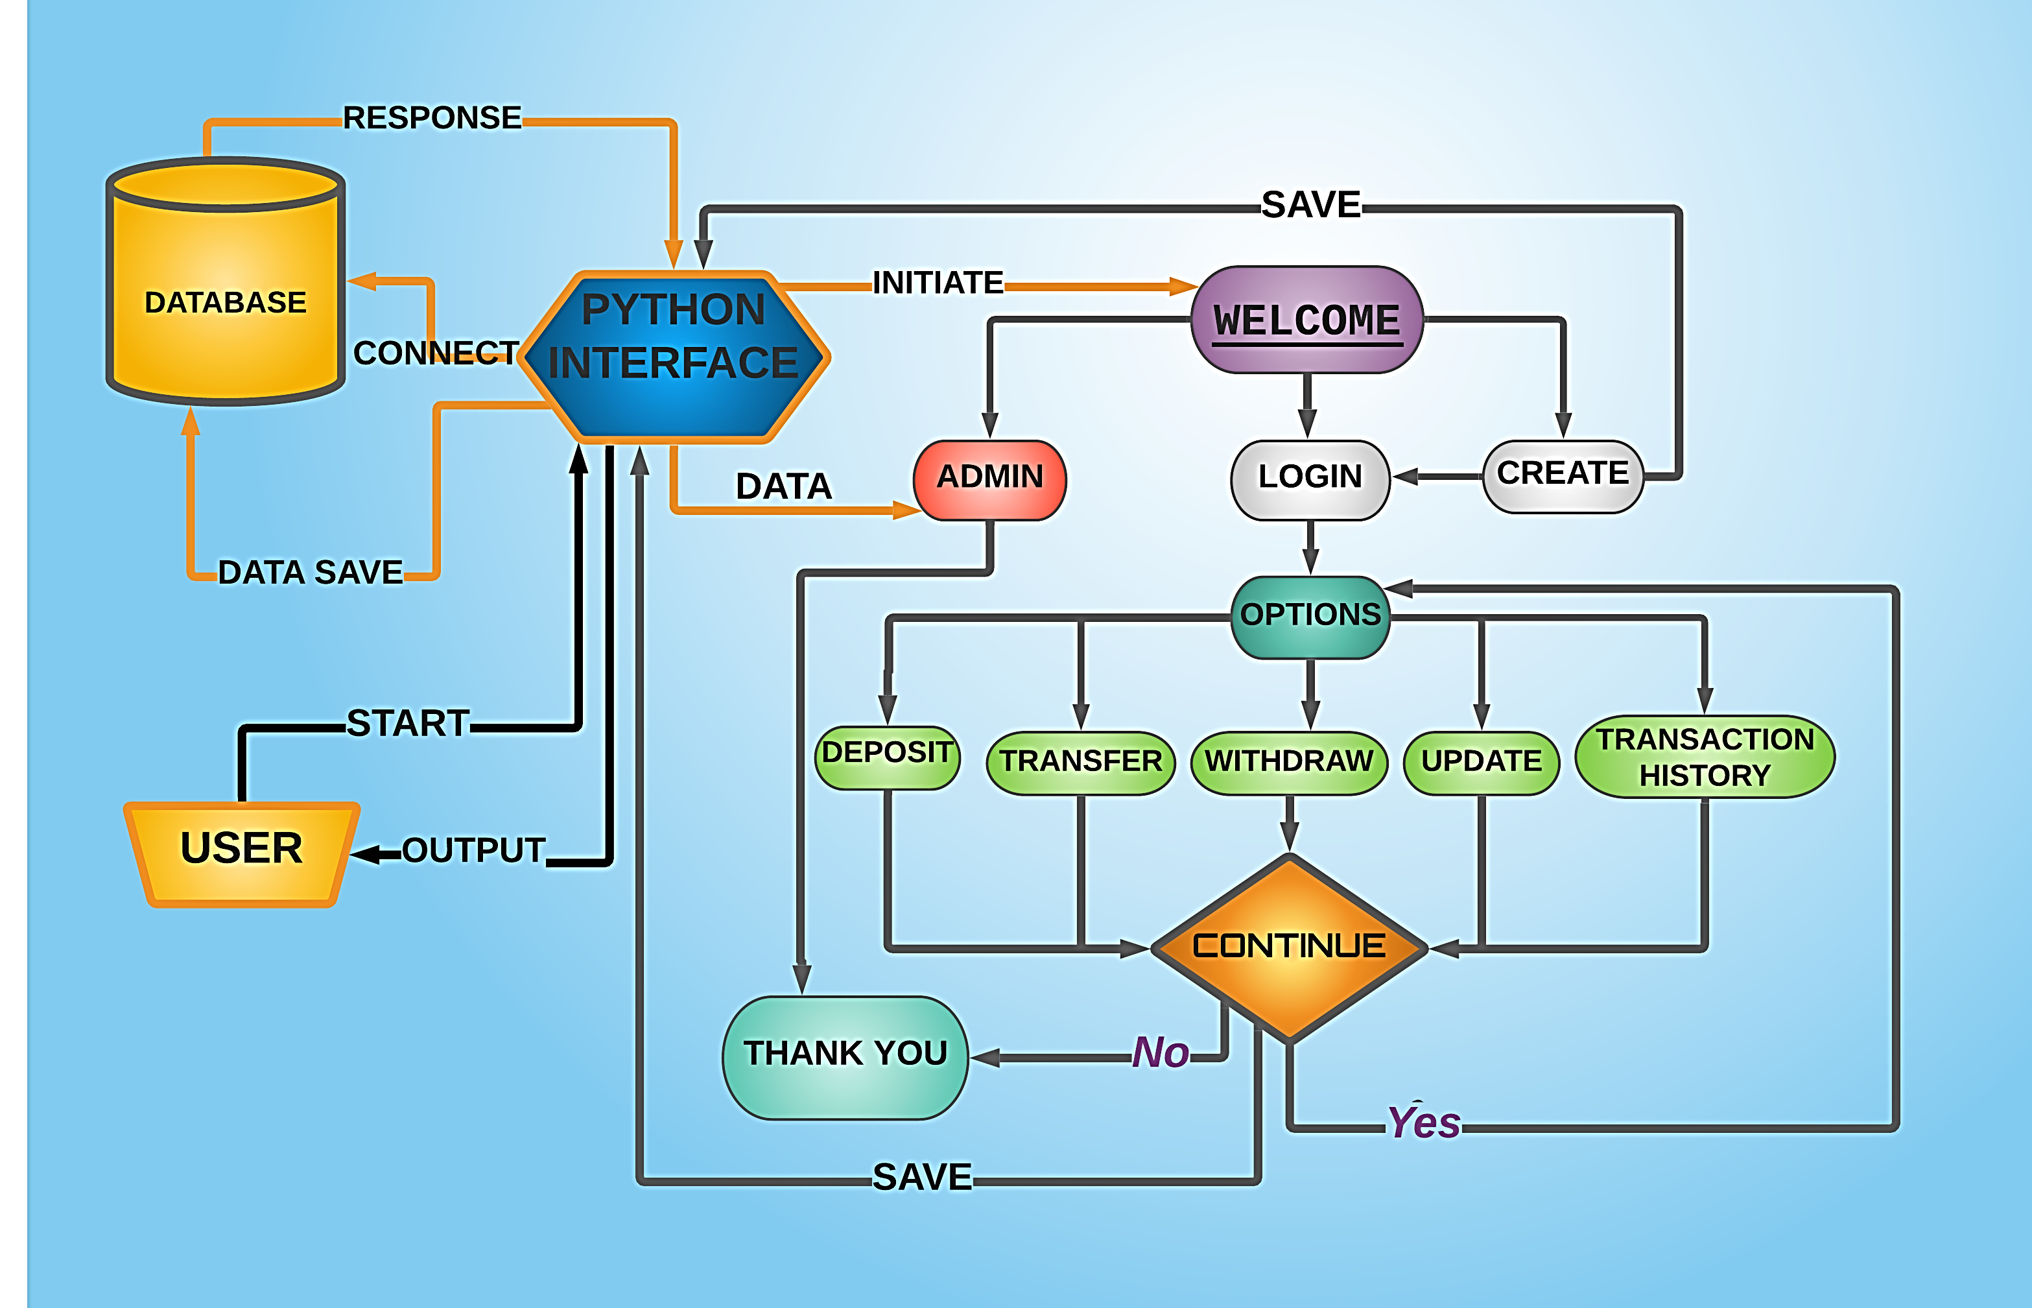
FLOW OF CONTROL :-

Slide 13

SOME IMPORTANT FUNCTIONS USED?
This Photo by Unknown Author is licensed under CC BY-SA

Slide 14
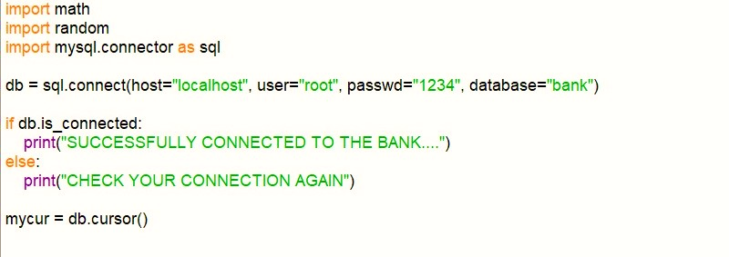
CONNECTING TO MySql THROUGH Python :-

Slide 15
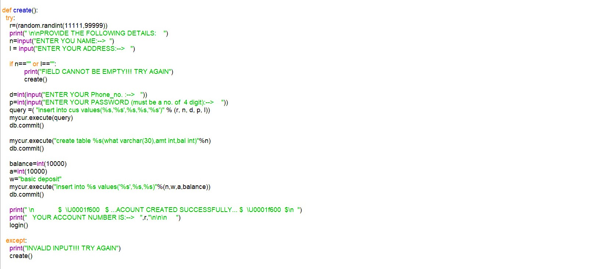
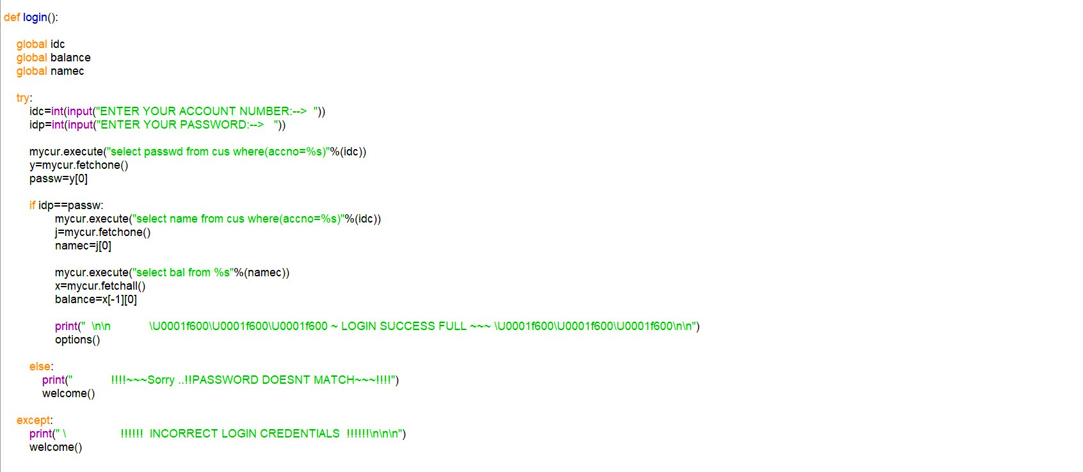
CREATING A BANK ACCOUNT :-
LOG-IN TO YOUR ACOUNT :-

Slide 16
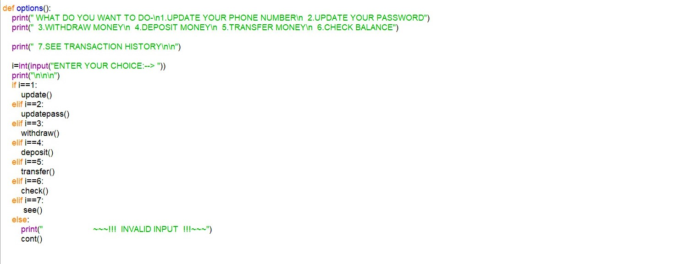
OPTIONS :-

Slide 17
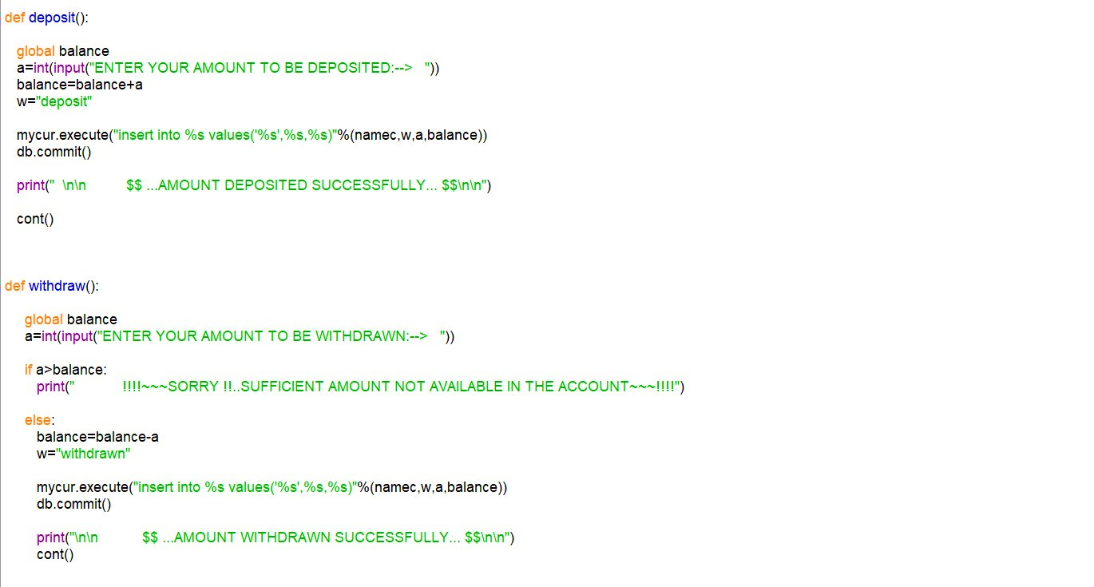
TRANSACTIONS :-

Slide 18
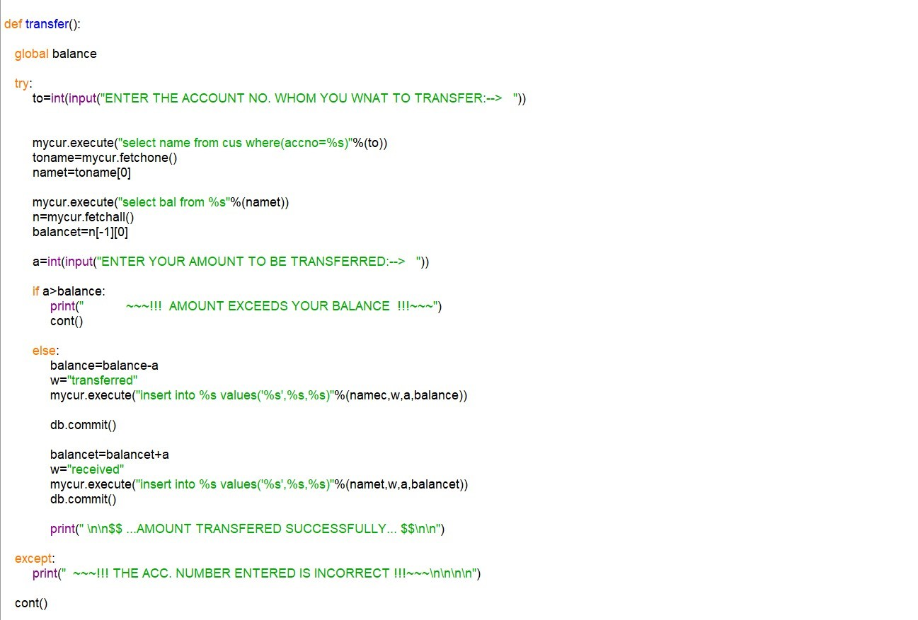
TRANFER TO
ANOTHER
ACCOUNT:-

Slide 19

Lets move to
VS Code!!

